Slide 1
TSDS PEIMS Reports
Simple Solution. Brighter Futures.

Slide 2
Agenda
PEIMS Fall Reports Review
Wrap Up and Helpful Resources

Slide 3
Reviewing the Information on all PEIMS Reports
The information in this document is to assist LEAs in understanding the importance of verifying the data on the PEIMS reports data submissions.
Occasionally, LEAs may discover when their accountability ratings are released, that there was incorrect or incomplete data reported in their PEIMS submission.
One common example is Economically Disadvantaged in the PEIMS Fall submission
This document will cover the importance of the data reported and how it could affect accountability or funding.
Notes:
WHY The ESC staff might find this information very elementary. However, it might be something that can be shared with the LEAs to help them.

Slide 4
Reviewing the Information on all PEIMS Reports
The LEA must verify the data on all reports.
PEIMS report verification should be a team effort.
All Special Program staff should review the reports for their program at district level and campus level.
Special Education Staff, GT Coordinator, ESL/BIL Program Staff, Homeless Liaison, Migrant Coordinator, Title 1 Director, CTE Coordinator
Business Office/HR should validate reports with staff and budget/actual data.
Campus Principals/Assistant Principals should review all campus level reports.
Attendance, Enrollment, Special Programs, Staff, Calendar, Discipline, Master Schedule, etc.
Campus Counselors should verify appropriate reports.
PRS reports, Discipline, Early Reader coding, Course Completion & Dual Credit, Graduate data, Dropout reports
Begin verification early to allow time for each team member to review and sign off on their reports.
Validate all reports for accuracy and completeness.
Failure to review the reports carefully could affect the LEA’s
funding and accountability!

Slide 5
PEIMS Fall Reports

Slide 6
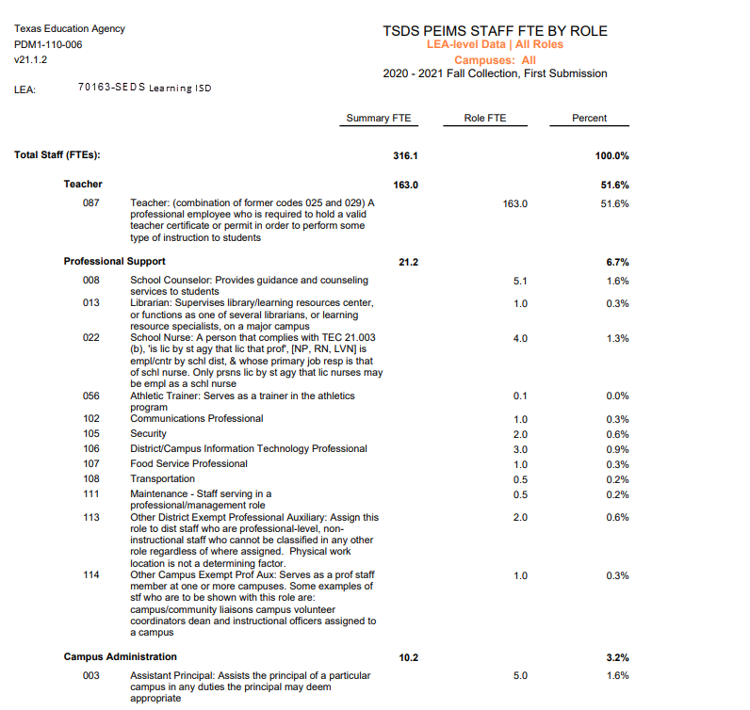
PEIMS Staff FTE by Role
Who should verify staff FTEs?
The LEA has a full-time nurse at each of their five campuses. There should be five nurse FTEs.
Contracted Staff?
The LEA has one Athletic Trainer who is contracted with a medical provider to assist at athletic events. He is not on the LEA’s payroll. Is this correct on the report?

Slide 7
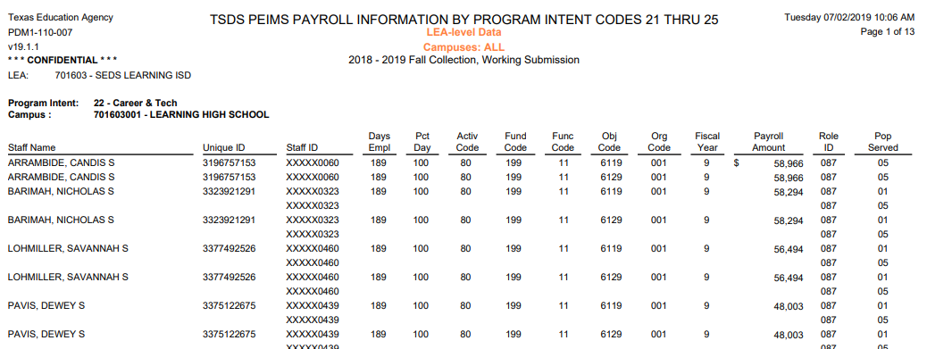
PEIMS Payroll Information by PIC 21-43
Who would review this report?
Dewey Pavis resigns on December 1st, how does that affect this PEIMS Fall Report?

Slide 8
SPECIAL REPORTS - District Q&A Report
Compare Previous Year to Current Year.
At the DAEP there is one full-time teacher and
five part-time teachers who come from the High School.
Are all five teachers coded to show that they provide
services at the DAEP campus?
3.4567
57%
Decrease
Notes:
General Fund Budgeted Expenditures
Program Membership
Graduates
Teacher FTE Count
All Reports

Slide 9
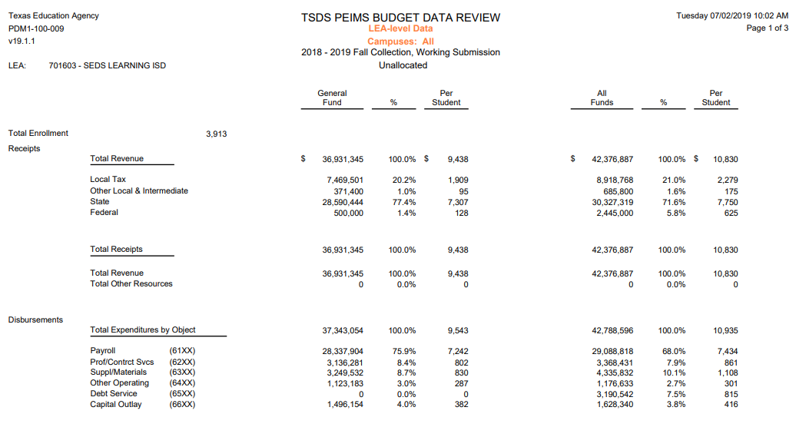
PEIMS Budget Data Review
Business office staff should review all the PEIMS Fall budget reports.
At the November board meeting, the board voted to transfer $20,000 from 64XX to 63XX. How does this affect the PEIMS Fall submission? Resub?
Notes:
Because the funds were moved after October snapshot date this change would not affect PEIMS Fall. Or Resub.

Slide 10
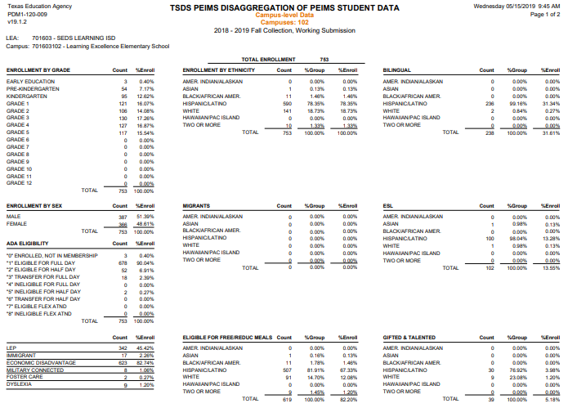
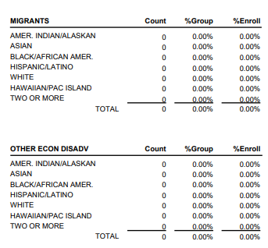
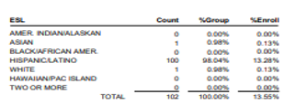
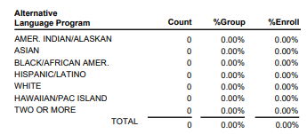
PEIMS Disaggregation of PEIMS Student Data
Campus staff will verify.
Should there be nine dyslexia students at this campus?
Is 82.20% of the total enrollment eligible for Free/Reduced Meals?
Generate the roster reports for the special programs and confirm the students on the lists are correct.
Notes:
This report is one place the LEA can verify the Economically Disadvantaged coding.

Slide 11
Special education student data
Generate this report by campus and ask the Special Education staff at the campus to verify and sign off on the report.
The Special Education staff who serve Mary would verify and correct the data since she is receiving Physical Therapy services.

Slide 12
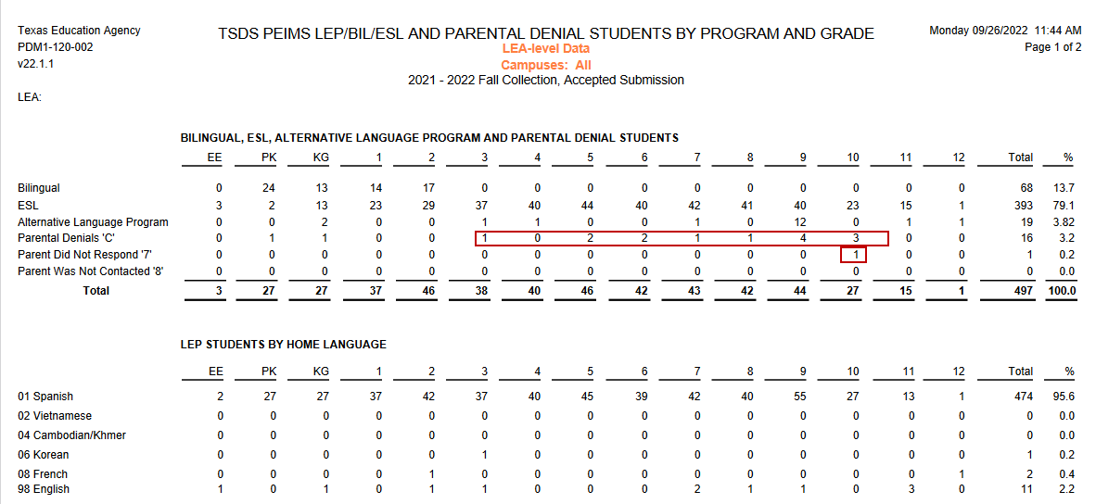
LEP/BIL/esl and parental denial
Generate this report for the LEA. Ask ESL/Bil Director to verify and sign off on the report.
Does the LEA have one “Parent Did Not Respond” and 16 “Parental Denials”? Does the LEA have 27 LEP students in 10th grade?

Slide 13
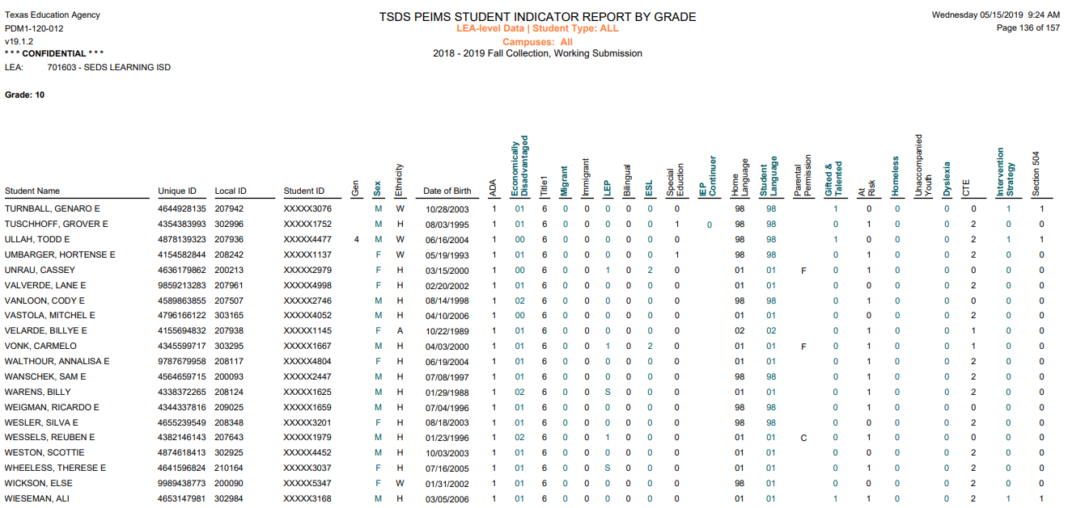
PEIMS student indicator report by grade
Generate this report that shows program participation for each student by grade.
Verify that each student in 10th grade who is LEP is coded correctly. Monitored? Why is the report showing 31 LEP and only 30 ESL students?
All special program staff should verify in the same way.
Notes:
This report is good report for verifying economically disadvantaged coding prior to submitting PEIMS Fall.
LEAs have had received their accountability rating and noticed that they had students who should have been coded economically disadvantaged and were not. This could have been avoided by closer verification prior to submitting their PEIMS Fall.
Student Data Review (PDM1-120-005) will provide a breakdown of the number of regular students reported as Economically Disadvantaged and the number of SPED students reported as Eco Dis.

Slide 14
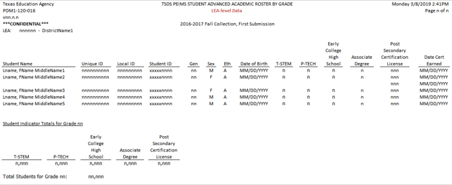
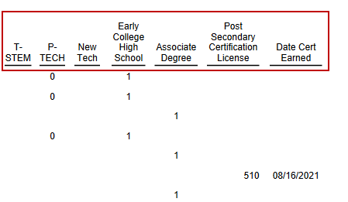
PEIMS student advanced academic roster
Campus counselors should review this report for each student’s advanced academic coding.

Slide 15
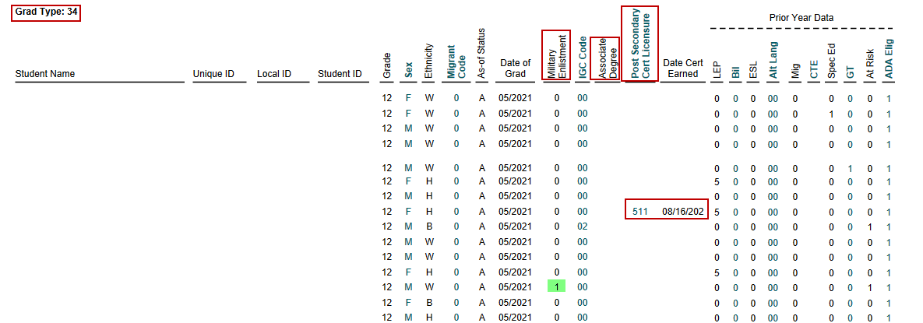
PEIMS Graduate Roster by Graduation Type
Senior counselors should verify that the information is correct for all graduates.
How many have a Military Enlistment code? Associate Degree? What does Grad Type code 05 indicate? What students earned a Post Secondary Cert/License?
PDM1-124-007
Notes:
Post Secondary Industry Certification Licensure Code 140=ASA Brakes
Grad Code 05 – SPED Completion Of IEP And Demonstrated Mastery Of Specific Employability And Self-Help Skills That Do Not Require Public School Services

Slide 16
Reviewing the Information on all PEIMS Reports
The LEA must verify the data on all reports.
PEIMS report verification should be a team effort.
All Special Program staff should review the reports for their program at district level and campus level.
Special Education Staff, GT Coordinator, ESL/BIL Program Staff, Homeless Liaison, Migrant Coordinator, Title 1 Director, CTE Coordinator
Business Office/HR should validate reports with staff and budget/actual data.
Campus Principals/Assistant Principals should review all campus level reports.
Attendance, Enrollment, Special Programs, Staff, Calendar, Discipline, Master Schedule, etc.
Campus Counselors should verify appropriate reports.
PRS reports, Discipline, Early Reader coding, Course Completion & Dual Credit, Graduate data, Dropout reports
Begin verification early to allow time for each team member to review and sign off on their reports.
Validate all reports for accuracy and completeness.
Failure to review the reports carefully could affect the LEA’s
funding and accountability!

Slide 17
Helpful resources
PEIMS Reports Help
TIMS Knowledge Base Articles

Slide 18
ESC 11 Contact information
ESC 11 TSDS PEIMS SUPPORT
Mary Morgan – 817-740-7618
Deanna Harris - 817-740-3677
TSDS TECHNICAL SUPPORT
Lynne Summerlin – 817-740-7679
ESC 11 STUDENT SUPPORT SUPERVISOR
Stephanie Smelley – 817-740-7602

